Slide 1
Unit-I Language Basics
Python interpreter and interactive mode – Tokens – Data types – Numbers and math functions – Input and Output operations – Comments – Reserved words – Indentation – Operators and expressions – Precedence and associativity – Type conversion – Debugging – Common errors in Python

Slide 2
INTRODUCTION TO PYTHON

Slide 3
Python
High-level programming language
Interpreted
Interactive
Object-Oriented Programming Language

Slide 4
Why Python?
Easy to learn
Can be used in broad range of applications
Open source
Procedural, Functional, Object-Oriented

Slide 5
Evolution of Python
Developed by Guido Van Rossum in early 1990s
Named after a comedy group Monty Python
Features derived from many languages like C, C++, Java and other scripting languages
Available under GNU General Public License ( Free, Open Source)
Python 3.8.5 - 20 July 2020 being the latest version

Slide 6
Features
Extensive Standard Library
Cross Platform Compatibility
Portable and Extendable
Databases and GUI Programming

Slide 7
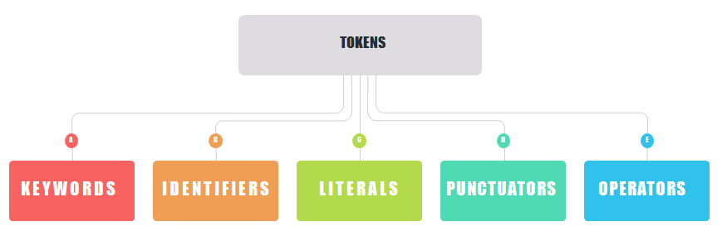
Tokens
Tokens are the smallest elements of a program, which are meaningful to the compiler.
Types of Tokens

Slide 8
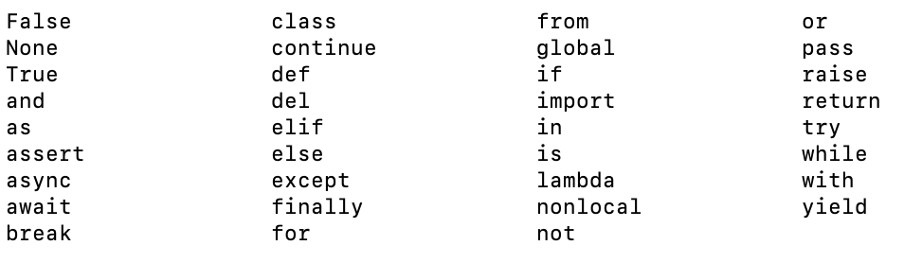
Keywords
Keywords are predefined, reserved words in Python
Each keyword is associated with specific features.
Keywords are case sensitive

Slide 9
Identifiers
Names given to anything that you want to identify in a program.
Helps to refer to that item from any place in a program

Slide 10
Identifiers
Rules to create an Identifier
Can contain letters in lower case (a-z), upper case (A-Z), digits (0-9), and underscore ( _ )
Identifier name can’t begin with a digit
Never use special symbols like !, @, #, $, %, etc.,
Can’t contain only digits
Can start with an underscore
Identifier names are case sensitive
Can’t use reserved keywords as an identifier name

Slide 11
Identifiers
Example:
student_name
studentName
session1
1Age
564
_year
class

Slide 12
Literals
Literals are the fixed or constant values. They can either be string, numeric or Boolean.
Numbers
43, 32.67, 6 + 4.13j
Strings
‘example’, “Day One”, ‘‘‘another example’’’
Boolean
True as ‘T’ and False as ‘F’

Slide 13
Delimiters
Delimiters are either grouping symbols, punctuation symbols, or symbols that assign/bind objects to names
( ) [ ] { } 🡪 Grouping
. , : ; 🡪 Punctuation
+= -= *= /= 🡪 Arithmetic assignment binding
(More in Operators)

Slide 14
Operators
Operators are the symbols which are used to perform operations between operands.
Unary Operators: Operators having single operand. Eg. +8, -7, etc Binary Operators: Operators working on 2 operands. Eg. 2+2, 4-3, 8*9, etc Similarly, there are Ternary Operators that work on 3 operands and so on.

Slide 15
Variable is an identifier used to refer a value in the program.
Variable is a name of the memory location. It is used to store data.
Variables

Slide 16
Variable
Rules to define a Variable
Can contain letters in lower case (a-z), upper case (A-Z), digits (0-9), and underscore ( _ )
Identifier name can’t begin with a digit
Never use special symbols like !, @, #, $, %, etc.,
Can’t contain only digits
Can start with an underscore
Identifier names are case sensitive
Can’t use reserved keywords as an identifier name

Slide 17
Declaring a Variable
Syntax:
variablename = value
Example:
day=1
Random Access
Memory
day
100
1

Slide 18
Declaring a Variable
Syntax:
variablename = value
Example:
language=“Python”
day=1
usage =100.00

Slide 19
Deleting a Variable
Syntax:
del variablename
Example:
language=“Python”
del language

Slide 20
DATA TYPES IN Python

Slide 21
Built-in Data Types
Variables can store data of different types, and different types can do different things.
Python has the following data types built-in by default, in these categories:
Text Type: | str
Numeric Types: | int, float, complex
Sequence Types: | list, tuple, range
Mapping Type: | dict
Set Types: | set, frozenset
Boolean Type: | bool

Slide 22
Data Types
Text Type : String
String(str):
Sequence of one or more characters (letters, numbers, symbols)
Example: message =‘Welcome’
day = “Day 1”
outcome =‘‘‘Happy Learning!’’’

Slide 23
Data Types
Numeric Types : Integer, Float, Complex
Integer (int):
Number that can be written without a fractional component
Example: x=3
Float (float):
Numbers that contain floating decimal points
Example: x=3.14

Slide 24
Data Types
Complex:
Number that can be expressed in the form a + bj, where a and b are real numbers, and j represents the imaginary unit
Example:
value=3+4.2j
3 → real
4.2 → imaginary

Slide 25
Data Types
Sequence Types
List
Ex: x = ["apple", "banana", "cherry"]
Tuple
Ex: x = ("apple", "banana", "cherry")
Range
Ex: x = range(6)

Slide 26
Data Types
Mapping Type(dict)
Dictionary
Representation → key: value pairs
Ex: x = {"name" : "John", "age" : 36}

Slide 27
Data Types
Set Types: Set, frozenset
These two functions are used for creating sets.
Set:
A set is an unordered and unindexed collection of unique elements.
Sets are mutable.(Changeable)
Since the elements are mutable and not in order, they don’t have hash values. So we can’t access the elements with the help of index numbers.
x = {"apple", "banana", "cherry"}

Slide 28
Data Types
Set Types: frozenset
These two functions are used for creating sets.
frozenset:
A frozenset is an unordered and unindexed collection of unique elements.
It is immutable and it is hashable.
It is also called an immutable set.
Since the elements are fixed, unlike sets you can't add or remove elements from the set.
x = frozenset({"apple", "banana", "cherry"})

Slide 29
Data Types
Boolean Type : bool
Variables are defined by the True and False keywords
Example:
a = True
b = False
x = bool(5)

Slide 30
Numbers and Math Functions
Numbers: Integers and Floating Point Numbers
Integer:
An integer is a whole number with no decimal places. For example, 1 is an integer, but 1.0 isn’t. The name for the integer data type is int, which see with type():
>>> type(1)
<class 'int'>

Slide 31
Numbers and Math Functions
>>> num=25
The value 25 is called as integer literal because the integer is literally typed into the code.
>>>int(“25”)
int(“25”) is not an integer literal because the integer value is created from a string.

Slide 32
Numbers and Math Functions
In Python, we can’t use commas to group digits in integer literals, but we can use underscores (_). Both of the following are valid ways to represent the number one million as an integer literal:
>>> 1000000 1000000
>>> 1_000_000 1000000
There’s no limit to how large an integer can be, which might be surprising considering that computers have a finite amount of memory. Try typing the largest number you can think of into IDLE’s interactive window. Python can handle it with no problem!

Slide 33
Numbers and Math Functions
Floating Point:
A floating-point number, or float for short, is a number with a decimal place
>>>type(1.0)
Class <‘float’>
Like integers , floats can be created from floating point literals or by converting a string with float():
>>>float(“1.25”)
1.25

Slide 34
.
Numbers and Math Functions
There are three ways to represent a floating-point literal. Each of the following creates a floating-point literal with a value of one million:
>>> 1000000.0 1000000.0
>>> 1_000_000.0 1000000.0
>>> 1e6 1000000.0
E notation is short for exponential notation. 1e6 is equivalent to 1×10⁶
Python also uses E notation to display large floating-point numbers:
>>> 200000000000000000.0
2e+17
The + sign indicates that the exponent 17 is a positive number.

Slide 35
.
Numbers and Math Functions
Python also use negative numbers as the exponent:
The literal 1e-4 is interpreted as 10 raised to the power -4, which is 1/10000, or 0.0001. m size.
>>> 1e-4
0.0001
The maximum floating-point number depends on our system, but something like 2e400 ought to be well beyond most machines’ capabilities .

Slide 36
.
Numbers and Math Functions
When we reach the maximum floating-point number, Python returns a special float value, inf:
>>> 2e400
inf
inf stands for infinity,it just means that number is beyond the maximum floating point value allowed on our computer.. But type is still float only
>>>-2e400
-inf
-inf stands for negative infinity and represents negative floating point number that is beyond the minimum floating point number allowed on our computer.

Slide 37
.
Numbers and Math Functions
a complex number is a number with two distinct components: a real part and an imaginary part.
>>> n = 1 + 2j
When we inspect the value of n, notice that Python wraps the number with parentheses:
>>> n
(1+2j)
Imaginary numbers come with two properties, .real and .imag, that return the real and imaginary components of the number, respectively:
>>> n.real
1.0
>>> n.imag
2.0
Notice that Python returns both the real and imaginary components as floats, even though they were specified as integers.

Slide 38
.
Numbers and Math Functions
Complex numbers also have a .conjugate() method that returns the complex conjugate of the number:
>>> n.conjugate()
(1-2j)
For any complex number, its conjugate is the complex number with the same real part and an imaginary part that is the same in absolute value but with the opposite sign. So in this case, the complex conjugate of 1 + 2j is 1 - 2j.
The .real and .imag properties don’t need parentheses after them like .conjugate() does.
The .conjugate() method is a function that performs an action on a complex number, whereas .real and .imag don’t perform any action—they just return some information about the number.

Slide 39
.
Numbers and Math Functions
Except for the floor division operator (//), all the arithmetic operators that work with floats and integers will also work with complex numbers.
>>> a = 1 + 2j
>>> b = 3 - 4j
>>> a + b
(4-2j)
>>> a - b
(-2+6j)
>>> a * b
(11+2j)

Slide 40
.
Numbers and Math Functions
>>> a ** b
(932.1391946432212+95.9465336603415j)
>>> a / b
(-0.2+0.4j)
>>> a // b
Traceback (most recent call last):
File "<stdin>", line 1, in <module>
TypeError: can't take floor of complex number.

Slide 41
.
Numbers and Math Functions
Interestingly, although not surprising from a mathematical point of view, int and float objects also have .real and .imag properties as well as the .conjugate() method:
>>> x = 42 >>> x.real 42 >>> x.imag 0 >>> x.conjugate() 42 | >>> y = 3.14 >>> y.real 3.14 >>> y.imag 0.0 >>> y.conjugate() 3.14
For floats and integers, .real and .conjugate() always return the number itself, and .imag always returns 0.
One thing to notice, however, is that n.real and n.imag return an integer if n is an integer and a float if n is a float.

Slide 42
.
Numbers and Math Functions
Built-in Math Functions:
1. The min() and max() functions can be used to find the lowest or highest value
x = min(5, 10, 25)
y = max(5, 10, 25)
print(x)
print(y)
2. The abs() function returns the absolute (positive) value of the specified number:
x = abs(-7.25)
print(x)
Output: 7.25

Slide 43
.
Numbers and Math Functions
Math Functions:
3. The pow(x, y) function returns the value of x to the power of y.
x = pow(4, 3)
print(x)
Return the value of 4 to the power of 3 (same as 4 * 4 * 4)

Slide 44
.
Numbers and Math Functions
Math Modules:
In python a number of mathematical operations can be performed with ease by importing a module named “math” which defines various functions which makes our tasks easier.
1. ceil() :- This function returns the smallest integral value greater than the number. If number is already integer, same number is returned.
import math
a = 2.3
# returning the ceil of 2.3
print ("The ceil of 2.3 is : ", end="")
print (math.ceil(a))
The ceil of 2.3 is : 3

Slide 45
.
Numbers and Math Functions
Math Modules:
2. floor() :- This function returns the greatest integral value smaller than the number. If number is already integer, same number is returned.
import math
a = 2.3
# returning the floor of 2.3
print ("The floor of 2.3 is : ", end="")
print (math.floor(a))
The floor of 2.3 is : 2

Slide 46
Numbers and Math Functions
Math Modules:
3. fabs() :- This function returns the absolute value of the number
4. factorial() :- This function returns the factorial of the number. An error message is displayed if number is not integral.
import math
a = -10
b= 5
# returning the absolute value.
print ("The absolute value of -10 is : ", end="")
print (math.fabs(a)) Output: The absolute value of -10 is : 10.0
# returning the factorial of 5
print ("The factorial of 5 is : ", end="")
print (math.factorial(b)) Output: The factorial of 5 is : 120

Slide 47
Numbers and Math Functions
Math Modules:
5.gcd() :- This function is used to compute the greatest common divisor of 2 numbers.
import math
# returning the gcd of 15 and 5
print ("The gcd of 5 and 15 is : ", end="")
print (math.gcd(5,15))
The gcd of 5 and 15 is : 5
6. sqrt() :- returns the square root of a number
import math
x = math.sqrt(64)
print(x)

Slide 48
Input/Output Functions
Built-in functions used to perform Input/Output operation in Python
Input operation:
To get the input from the user
Function Used:
input( )

Slide 49
Input/Output Functions
Input operation:
Syntax:
variablename = input([prompt ])
Here, prompt is the string we wish to display on the screen. It is optional.
Ex:
name=input(“Enter your Name:”)
Enter your Name:

Slide 50
Input/Output Functions
Output Operation:
To display the output
Function Used:
print( )

Slide 51
Input/Output Functions
Output operation:
Syntax:
print([output ])
Example code:
language=“Python”
print(language)
Output:
Python

Slide 52
Input/Output Functions
Output operation:
Example code:
language=“Python”
print(‘You are learning ’,language)
Output:
You are learning Python

Slide 53
Input/Output Functions
input( ) 🡪All the inputs are considered as strings
Example code:
number1=input(“Enter a number:”)
number2=input(“Enter another number:”)
print(“Result:”,number1+number2)
Output:
Enter a number :5
Enter another number:6
Result:56

Slide 54
Input/Output Functions
Example code:
number1=int(input(“Enter a number:”))
number2=int(input(“Enter another number:”))
print(“Result:”,number1+number2)
Output:
Enter a number :5
Enter another number:6
Result:11

Slide 55
Formatting the Output
Example code:
session=“Session 1”
language=“Python”
print(session, language)
Output:
Session 1 Python

Slide 56
Formatting the Output
Example code:
print('This is an {0} for formatting the {1}'.format(‘example’, ‘output’))
print('This is an { } for formatting the {}'.format(‘example’, ‘output’))
Output:
This is an example for formatting the output

Slide 57
Formatting the Output
Example code:
session=“Session 1”
language=“Python”
print('This is {0}.You are learning {1}'.format(session, language)
Output:
This is Session 1.You are learning Python

Slide 58
Python Output
Syntax of print()
The actual syntax of the print function accepts 5 parameters
print(object= separator= end= file= flush=)
object - value(s) to be printed
sep (optional) - allows us to separate multiple objects inside print().
end (optional) - allows us to add add specific values like new line "\n", tab "\t"
file (optional) - where the values are printed. It's default value is sys.stdout (screen)
flush (optional) - boolean specifying if the output is flushed or buffered. Default: False

Slide 59
Python Output
1. Python Print Statement
print('Good Morning!')
print('It is rainy today’)
Output:
Good Morning!
It is rainy today

Slide 60
Python Output
2.Python print() with end Parameter
# print with end whitespace
print('Good Morning!', end= ' ')
print('It is rainy today’)
Output:
Good Morning! It is rainy today

Slide 61
Python Output
3. Python print() with sep parameter
print('New Year', 2023, 'See you soon!', sep= '. ')
Output:
New Year. 2023. See you soon!
Print Concatenated Strings
print('Programiz is ' + 'awesome.’)
Output:
Programiz is awesome.

Slide 62
Ex: Python user Input
# using input() to take user input
num = input('Enter a number: ')
print('You Entered:', num)
print('Data type of num:', type(num))
Output:
Enter a number: 10
You Entered: 10
Data type of num: <class 'str'>

Slide 63
Comment Line
Comments in Python are the lines in the code that are ignored by the interpreter during the execution of the program.
Comments enhance the readability of the code and help the programmers to understand the code very carefully.

Slide 64
There are three types of comments in python:
Single line Comments
Multiline Comments
Docstring Comments
Comment Line

Slide 65
Comment Line:
Single-Line Comments in Python
Python single-line comment starts with the hashtag symbol (#) with no white spaces and lasts till the end of the line.
If the comment exceeds one line then put a hashtag on the next line and continue the comment.
# sample comment
name = “I CSE-A"
print(name)
Output: I CSE-A

Slide 66
Comment Line:
Multi-Line Comments using multiple hashtags (#)
# Python program to demonstrate
# multiline comments
print("Multiline comments")
Single-line comments using string literals
'This will be ignored by Python’
Multiline comments using string literals
""" Python program to demonstrate
multiline comments"""
print("Multiline comments")

Slide 67
Comment Line:
Docstring in Python
Python docstring is the string literals with triple quotes that are appeared right after the function.
It is used to associate documentation that has been written with Python modules, functions, classes, and methods.
It is added right below the functions, modules, or classes to describe what they do.
In Python, the docstring is then made available via the __doc__ attribute.
Ex:
def multiply(a, b):
"""Multiplies the value of a and b"""
return a*b
# Print the docstring of multiply function
print(multiply.__doc__)

Slide 68
Comment Line:
Advantages of comments in Python
Comments are generally used for the following purposes:
Code Readability
Explanation of the code or Metadata of the project
Prevent execution of code
To include resources

Slide 69
Reserved Words:
Python reserved words (also called keywords) has a predefined meaning and syntax in the language which Python uses for its syntax and internal processing.

Slide 70
Reserved Words:
All the keywords except True, False and None are in lowercase and they must be written as they are.
These cannot be used as variable names, function names, or any other identifiers.
If any of the keywords is used as a variable, then we will get the error message SyntaxError: invalid syntax

Slide 71
Reserved Words:
False
It is a boolean operator that represents the opposite of True.
Ex:
print (5 == 10)
Output:
False
Since the values are not actually equal, it returns False.

Slide 72
Reserved Words:
del
The del statement is used to delete an object in Python.
Input:
name = [‘Ben’, ‘Nick’, ‘Steph’]
del name[1]
print (name)
Output:
[‘Ben’, ‘Steph’]

Slide 73
Reserved Words:
import
This statement is used to import modules to the project.
Input:
import numpy
import math
This statement will import the NumPy and the math library into the project.

Slide 74
Reserved Words:
return
This keyword is used to exit a function or a method and return some value.
Input:
def sub(x, y):
return x + y
print (sub(5, 4))
Output:
9
The function returns the sum of the two variables.

Slide 75
Indentation in python
Indentation is a very important concept of Python because without properly indenting the Python code, will end up seeing Indentation Error and the code will not get compiled.
Python indentation refers to adding white space before a statement to a particular block of code.
In another word, all the statements with the same space to the right, belong to the same code block.

Slide 76
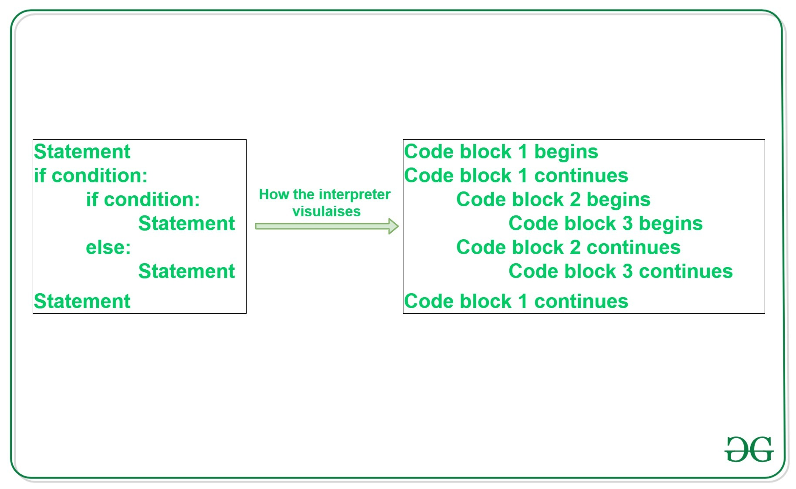
Indentation in python

Slide 77
Indentation in python
Python indentation is a way of telling a Python interpreter that the group of statements belongs to a particular block of code. A block is a combination of all these statements.
Block can be regarded as the grouping of statements for a specific purpose. Most programming languages like C, C++, and Java use braces { } to define a block of code.
Python uses indentation to highlight the blocks of code. Whitespace is used for indentation in Python. All statements with the same distance to the right belong to the same block of code.

Slide 78
Indentation in python
# Python program showing
# indentation
site = ‘CSE-A'
if site == ‘CSE-A’:
print(“Hi I CSE-A”)
else:
print(‘Welcome I CSE-A.')
print('All set !')
Output:
Logging on to geeksforgeeks...
All set !

Slide 79
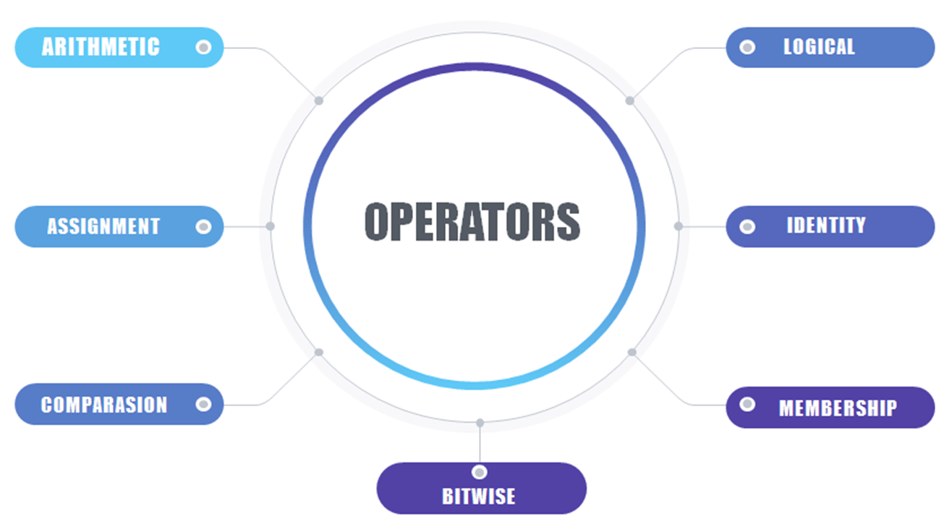
Operators
Operators in general are used to perform operations on values and variables.
These are standard symbols used for the purpose of logical and arithmetic operations.
OPERATORS: These are the special symbols. Eg- + , * , /, etc.
OPERAND: It is the value on which the operator is applied.
Types of Operators in Python

Slide 80
Arithmetic Operators
Arithmetic operators are used with numeric values to perform common mathematical operations:
Operator | Name | Example
+ | Addition | x + y
- | Subtraction | x - y
* | Multiplication | x * y
/ | Division | x / y
% | Modulus | x % y
** | Exponentiation | x ** y
// | Floor division | x // y

Slide 81
Arithmetic Operators
Division Operators
Division Operators allow you to divide two numbers and return a quotient, i.e., the first number or number at the left is divided by the second number or number at the right and returns the quotient.
There are two types of division operators:
Float division
Floor division
Float division
The quotient returned by this operator is always a float number, no matter if two numbers are integers. For example:
print(5/5)
print(-10/2)
print(20.0/2)
Output:
1.0
-5.0
10.0

Slide 82
Arithmetic Operators
Integer division( Floor division)
The quotient returned by this operator is dependent on the argument being passed.
If any of the numbers is float, it returns output in float.
It is also known as Floor division because, if any number is negative, then the output will be floored. For example:
print(10//3)
print (-5//2)
print (5.0//2)
print (-5.0//2)
Output:
3
-2
2.0
-2.0

Slide 83
Arithmetic Operators
Precedence of Arithmetic Operators in Python
P – Parentheses
E – Exponentiation
M – Multiplication (Multiplication and division have the same precedence)
D – Division
A – Addition (Addition and subtraction have the same precedence)
S – Subtraction
The modulus operator helps us extract the last digit/s of a number. For example:
x % 10 -> yields the last digit
x % 100 -> yield last two digits

Slide 84
Arithmetic Operators
# Examples of Arithmetic Operator
a = 9 b = 4
add = a + b
sub = a - b
mul = a * b
mod = a % b
p = a ** b
print(add)
print(sub)
print(mul)
print(mod)
print(p)
Output:
13
5
36
1
6561

Slide 85
Comparison Operators
In Python Comparison of Relational operators compares the values. It either returns True or False according to the condition.
Operator | Name | Example
== | Equal | x == y
!= | Not equal | x != y
> | Greater than | x > y
< | Less than | x < y
>= | Greater than or equal to | x >= y
<= | Less than or equal to | x <= y

Slide 86
Comparison Operators
In python, the comparison operators have lower precedence than the arithmetic operators. All the operators within comparison operators have same precedence order.
# Examples of Relational Operators
a = 13
b = 33
# a > b is False
print(a > b)
# a < b is True
print(a < b)
# a == b is False
print(a == b)
# a != b is True
print(a != b)
# a >= b is False
print(a >= b)
# a <= b is True
print(a <= b)

Slide 87
Logical Operators
Python Logical operators perform Logical AND, Logical OR, and Logical NOT operations. It is used to combine conditional statements.
Precedence of Logical Operators in Python
The precedence of Logical Operators in python is as follows:
Logical not
logical and
logical or
Operator | Description | Syntax
and | Logical AND: True if both the operands are true | x and y
or | Logical OR: True if either of the operands is true | x or y
not | Logical NOT: True if the operand is false | not x

Slide 88
Logical Operators
# Examples of Logical Operator
a = True
b = False
# Print a and b is False
print(a and b)
# Print a or b is True
print(a or b)
# Print not a is False
print(not a)

Slide 89
Bitwise Operators
Python Bitwise operators act on bits and perform bit-by-bit operations. These are used to operate on binary numbers.
Operator | Description | Syntax
& | Bitwise AND | x & y
| | Bitwise OR | x | y
~ | Bitwise NOT | ~x
^ | Bitwise XOR | x ^ y
>> | Bitwise right shift | x>>
<< | Bitwise left shift | x<<

Slide 90
Bitwise Operators
The precedence of Bitwise Operators in python is as follows:
Bitwise NOT
Bitwise Shift
Bitwise AND
Bitwise XOR
Bitwise OR

Slide 91
Bitwise Operators
# Examples of Bitwise operators a = 10 b = 4 # Print bitwise AND operation print(a & b) # Print bitwise OR operation print(a | b) | # Print bitwise NOT operation print(~a) # print bitwise XOR operation print(a ^ b) # print bitwise right shift operation print(a >> 2) # print bitwise left shift operation print(a << 2)
Output:
0 //AND
14 //OR
-11 //NOT
14 //XOR
2 //RIGHT SHIFT
40 //LEFT SHIFT
Left shift=num*2^no. of shift
Right shift=num/2^no. of shift
Not=minus(number+1)

Slide 92
Assignment Operators
Operator | Description | Syntax
= | Assign the value of the right side of the expression to the left side operand | x = y + z
+= | Add AND: Add right-side operand with left-side operand and then assign to left operand | a+=b a=a+b
-= | Subtract AND: Subtract right operand from left operand and then assign to left operand | a-=b a=a-b
*= | Multiply AND: Multiply right operand with left operand and then assign to left operand | a*=b a=a*b
/= | Divide AND: Divide left operand with right operand and then assign to left operand | a/=b a=a/b
%= | Modulus AND: Takes modulus using left and right operands and assign the result to left operand | a%=b a=a%b

Slide 93
Assignment Operators
Operator | Description | Syntax
//= | Divide(floor) AND: Divide left operand with right operand and then assign the value(floor) to left operand | a//=b a=a//b
**= | Exponent AND: Calculate exponent(raise power) value using operands and assign value to left operand | a**=b a=a**b
&= | Performs Bitwise AND on operands and assign value to left operand | a&=b a=a&b
|= | Performs Bitwise OR on operands and assign value to left operand | a|=b a=a|b
^= | Performs Bitwise xOR on operands and assign value to left operand | a^=b a=a^b
>>= | Performs Bitwise right shift on operands and assign value to left operand | a>>=b a=a>>b
<<= | Performs Bitwise left shift on operands and assign value to left operand | a <<= b a= a << b

Slide 94
Assignment Operators
# Examples of Assignment Operators
a = 10
# Assign value
b = a
print(b) //10
# Add and assign value
b += a
print(b) //20
# Subtract and assign value
b -= a
print(b) //10
# multiply and assign
b *= a
print(b) //100
# bitwise left shift operator
b <<= a
print(b) //102400

Slide 95
Identity Operators
In Python, is and is not are the identity operators both are used to check if two values are located on the same part of the memory. Two variables that are equal do not imply that they are identical.
is True if the operands are identical
is not True if the operands are not identical
Example:
x1 = 5
y1 = 5
x2 = 'Hello'
y2 = 'Hello'
x3 = [1,2,3]
y3 = [1,2,3]
print(x1 is not y1) # prints False
print(x2 is y2) # prints True
print(x3 is y3) # prints False

Slide 96
Membership Operators
In Python, in and not in are the membership operators that are used to test whether a value or variable is in a sequence.
in True if value is found in the sequence
not in True if value is not found in the sequence
Example:
x = 24
y = 20
list = [10, 20, 30, 40, 50]
if (x not in list):
print("x is NOT present in given list")
else:
print("x is present in given list")
if (y in list):
print("y is present in given list")
else:
print("y is NOT present in given list")

Slide 97
Ternary Operators
In Python, Ternary operators also known as conditional expressions are operators that evaluate something based on a condition being true or false.
Syntax : [on_true] if [expression] else [on_false]
Example:
a, b = 10, 20
# Copy value of a in min if a < b else copy b
min = a if a < b else b
print(min) //10

Slide 98
Operator Precedence
Operator precedence describes the order in which operations are performed.
Operator Description
() Parentheses
** Exponentiation
+x -x ~x Unary plus, unary minus, and bitwise NOT
* / // % Multiplication, division, floor division, and modulus
+ - Addition and subtraction
<< >> Bitwise left and right shifts
& Bitwise AND
^ Bitwise XOR
| Bitwise OR
== != > >= < <=
is is not in not in Comparisons, identity, and membership operators
not Logical NOT
and AND
or OR

Slide 99
Operator Precedence
If two operators have the same precedence, the expression is evaluated from left to right.
Example:
(5 + 4 - 7 + 3)
(100 + 5 * 3)
((6 + 3) - (6 + 3))
10 + 20 * 30
100 / 10 * 10
100 + 200 / 10 - 3 * 10

Slide 100
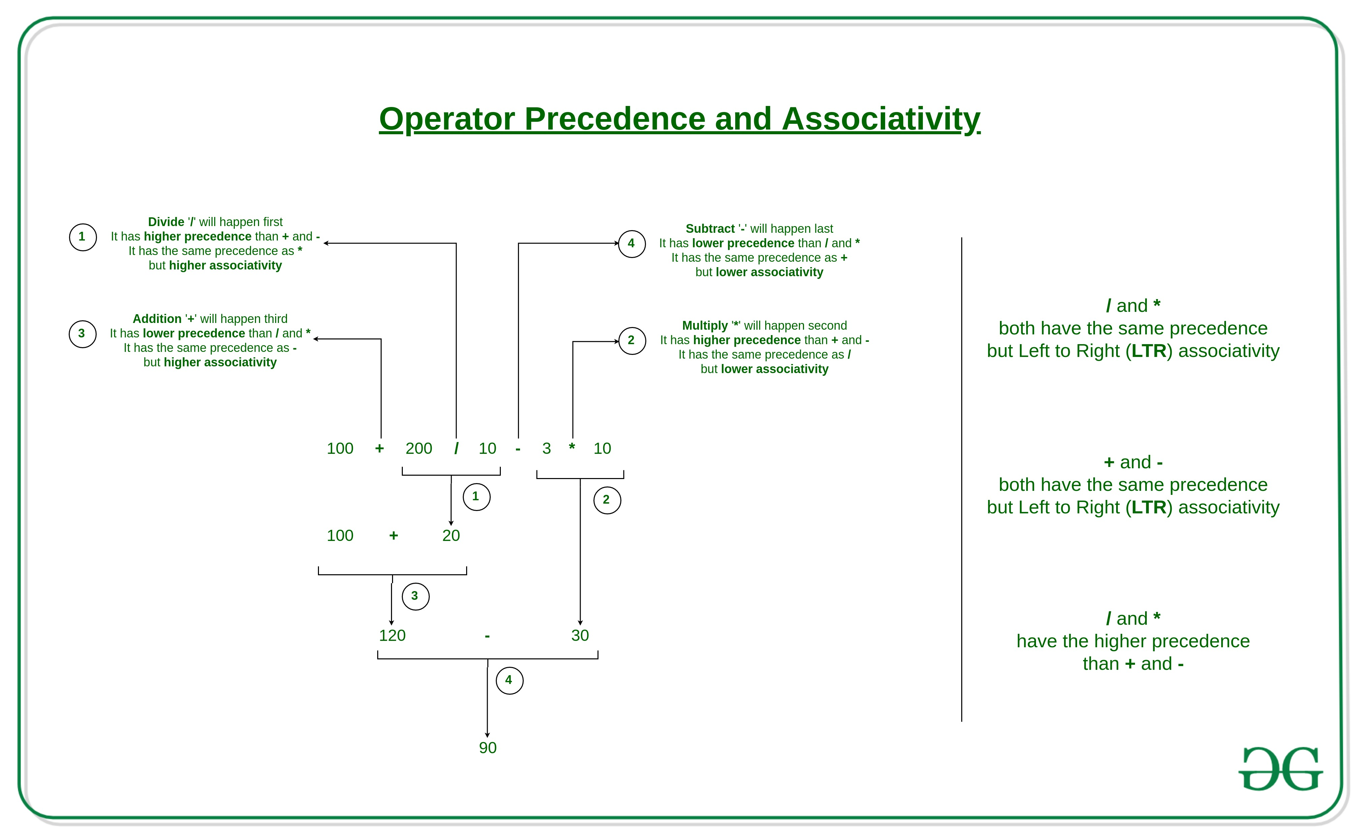
Operator Precedence

Slide 101
Operator Associativity
right-to-left associativity
Exponent **
Logical NOT not
= Assignment
+= -= Addition/subtraction assignment
*= /= Multiplication/division assignment
%= &= Modulus/Bitwise AND assignment
^= |= Bitwise exclusive/inclusive OR assignment
<<= >>= Bitwise shift left/right assignment

Slide 102
Operator Associativity
right-to-left associativity
2 ** 3 ** 2 is calculated as
# 2 ** (3 ** 2)
# not as (2 ** 3) ** 2

Slide 103
Example…Try this….
suppose you are a university student, and you need to pay $4535 tuition fee for the next semester. The college is giving you a discount of 10% on the early payment of your tuition fee. Since it’s a good offer you decided to make an early payment. Can you find out how much money you have to pay?

Slide 104
Example…Try this….
fee=4535
dis_per=10
dis_amount=(dis_per/100)*fee
dis_fee=fee-dis_amount
print(“Fee after discount”,dis_fee)

Slide 105
Type Conversion
Type conversion is the process of converting data of one type to another.
There are two types of type conversion in Python.
Implicit Conversion - automatic type conversion
Explicit Conversion - manual type conversion

Slide 106
Implicit Conversion
In certain situations, Python automatically converts one data type to another.
Example 1: Converting integer to float
integer_number = 123
float_number = 1.23
new_number = integer_number + float_number
# display new value and resulting data type
print("Value:",new_number)
print("Data Type:",type(new_number))
Output:
Value: 124.23
Data Type: <class 'float'>

Slide 107
Explicit Conversion
In Explicit Type Conversion, users convert the data type of an object to required data type.
We use the built-in functions like int(), float(), str(), etc to perform explicit type conversion.
This type of conversion is also called typecasting because the user casts (changes) the data type of the objects.

Slide 108
Explicit Conversion
Example 2: Addition of string and integer Using Explicit Conversion
num_string = '12'
num_integer = 23
print("Data type of num_string before Type Casting:",type(num_string))
# explicit type conversion
num_string = int(num_string)
print("Data type of num_string after Type Casting:",type(num_string))
num_sum = num_integer + num_string
print("Sum:",num_sum)
print("Data type of num_sum:",type(num_sum))
Output:
Data type of num_string before Type Casting: <class 'str'>
Data type of num_string after Type Casting: <class 'int'>
Sum: 35
Data type of num_sum: <class 'int'>

Slide 109
Type Conversion
Key Points to Remember
Type Conversion is the conversion of an object from one data type to another data type.
Implicit Type Conversion is automatically performed by the Python interpreter.
Python avoids the loss of data in Implicit Type Conversion.
Explicit Type Conversion is also called Type Casting, the data types of objects are converted using predefined functions by the user.
In Type Casting, loss of data may occur as we enforce the object to a specific data type.

Slide 110
Debugging
Debugging means the complete control over the program execution.
Developers use debugging to overcome program from any bad issues.
So debugging is a healthier process for the program and keeps the diseases bugs far away.
Python comes with by default debugger that is easy to import and use.
Preconditions for Effective Debugging:
Understand the algorithm
Check correctness
Code Tracing
Peer Reviews

Slide 111
Common Errors in python
Python is a popular programming language that is easy to learn and use. But like any programming language, Python is prone to errors.
Syntax Errors
Indentation Errors
Name Errors
Type Errors
Index Errors
Key Errors
Attribute Errors

Slide 112
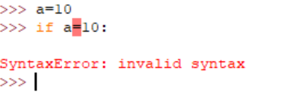
Syntax Errors in python
Syntax errors occur , have a typo or other mistake in the code that causes it to be invalid syntax. These errors are usually caught by Python's interpreter when try to run the code.
Trying to assign the value 10 to the variable x using the assignment operator (=) inside an if statement.

Slide 113
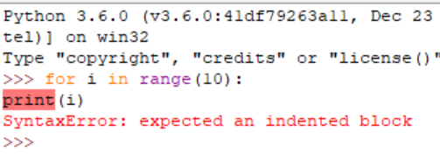
Indentation Errors in python
Python uses whitespace to indicate blocks of code, so proper indentation is critical.
Use four spaces for each level of indentation.
Don't mix tabs and spaces for indentation.
Make sure indentation is consistent throughout your code.

Slide 114
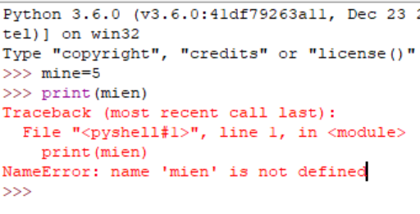
Name Errors in python
Name errors occur when we try to use a variable or function that hasn't been defined.
For example, if we try to print the value of a variable that hasn't been assigned a value yet, we'll get a name error.

Slide 115
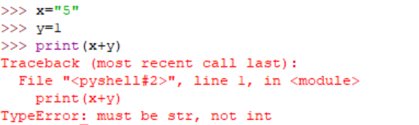
Type Errors in python
Type errors occur when we try to perform an operation on data of the wrong type.
For example, we might try to add a string and a number, or might try to access an attribute of an object that doesn't exist.

Slide 116
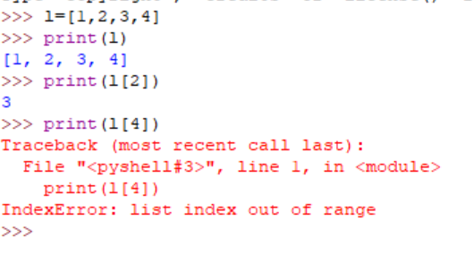
Index Errors in python
Index errors occur when we try to access an item in a list or other sequence using an index that is out of range.
For example, if we try to access the fifth item in a list that only has four items, we'll get an index error.

Slide 117
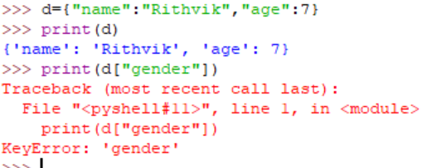
key Errors in python
Key errors occur when we try to access a dictionary using a key that doesn't exist.
For example, if we try to access the value associated with a key that hasn't been defined in a dictionary, we'll get a key error.

Slide 118
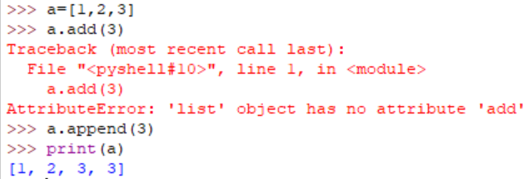
Attribute Errors in python
Attribute errors occur when we try to access an attribute of an object that doesn't exist, or when we try to access an attribute in the wrong way.
There are several different types of attributes in Python:
Instance attributes: These are attributes that belong to a specific instance of a class.
Class attributes: These are attributes that belong to a class rather than an instance.
Static attributes: These are attributes that belong to a class, but can be accessed without creating an instance of the class.

